Slide 1

WINTER TRAINING REPORT
ON
PYTHON 3
SUBMITTED BY:
1.DEEPAK GAUNIYAL
(01515002817)

Slide 2
WHY PYTHON 3 ?
The language's core philosophy is summarized in the document The Zen of Python (PEP 20), which includes aphorisms such as:
1. Beautiful is better than ugly.
2. Explicit is better than implicit.
3. Simple is better than complex.
4. Complex is better than complicated.
5. Readability counts
These are some factors which made the use of this language beyond a certain limit.
its simple-ness, everything in one kind of policy is what made it shine in todays world.

Slide 3
DEVELOPMENT ENVIRONMENT
An IDE (or Integrated Development Environment) is a program dedicated to software development.
As the name implies, IDEs integrate several tools specifically designed for software development.
So these are the basic things which is require for god coding environment:
1.Save and reload code files
2.Run code from within the environment
3.Debugging support
4.Syntax highlighting
5.Automatic code formatting

Slide 4
PYTHON IDE AND CODE EDITORS
There are several Code editors and IDE in which one can code his/her program
Some of them are listed below:
Jupyter Notebook
Anaconda 3
Python 3.7
PyCharm
Visual Studio code
Sublime Text

Slide 5
PYTHON OBJECT & DATA STRUCTURE
So to understand python it is necessary to first have knowledge of these data objects and data structures.
So we are learning it from Scratch so various thing that we need to know before we proceed ahead are these basic things Operators :These are the constructs, which can manipulate the value of operands.
So basically they are divided into Arithmetic(+,-,/,*,//,**),Logical(and.not.or),
Assignment(=,+=,-=),Relational(>,<,==,>=),Bitwise(&,^),Membership(in,not in) ,Identity(is,is not)

Slide 6
What basic Things I have Learned about PYTHON 3
Taking Inputs
Printing something
Loops >> for and while
Python Statements >> If , else , elif
Loop Control statements >> break , continue , pass
Functions
Lists
Dictionaries and tuples
Strings
So these are the basics which made further programming life somewhat easier to understand as these are basics things which we use in almost every program . This is the base

Slide 7
By using previous basic things we have further go to other data types these generally includes:
Class
OOPS
Linked list
Queue
Priority Queue
Binary Trees
Graphs and all
So these are the advanced topics which become much easier to understand when we have knowledge of previous basic topics. That’s exactly how we proceeded in this course, go up step by step

Slide 8
What OOPS brings in Python !
Python has been an object-oriented language since it existed. Because of this, creating and using classes and objects are downright easy. One of the popular approach to solve a programming problem is by creating objects. This is known as Object-Oriented Programming (OOP). An object has two characteristics: attributes behavior.
It covers the following basic principles
Inheritance
Encapsulation
Polymorphism
Having Oops concept in an programming language always enhances aspects like security, durability of code , reusability of code , error reduction and all.

Slide 9
LIBRARIES AND MODULES
This is that advanced part of python which made it totally different from other languages. Python have various libraries and each of these libraries have various functions using which a complex to complex job can be done in a short spam of time as there are prebuild functions inside library who do this job. Here listed the most common libraries of Python 3:
Numpy : so it is the most important library to perform mathematical functions, this library made many tasks very easy like you can easily get 10 d array using this library you can add all elements of that array in one command, you don’t need to run 10 loops for that, and many such exciting math's functions.
Matplotlib: This library is basically used to see diagrammatical representation of our functions or tables like Graphs , histogram , pie charts etc.
Pandas: This library is usually used when we have to deal with data sets or we have to do data manipulation that is if we want to read something from our file or write to file. This library can also be useful when it comes to data handling part.

Slide 10
File handling
File handling in python 3 is basically a process in which while we are coding and we want to take some information from the file in system or I have gathered some information and I want to save it in a file than we use concept of file handling The two main basic operations are:
Reading from a file
f=open("myfile.txt","r")
line=f.readline()
Write into a file
f=open("D:\myfile.txt","w")
f.write("Hello I am Student of MSIT.")

Slide 11
Applications of python
In todays world python 3 has come up as a basic language for huge concepts of machine learning and data science. Its extensive libraries and ease of implementation of various complex function made it favorite for ML engineers.
Python is a versatile language you can also use it in applications like:
Web development
Software development
Games and 3D Graphics
Network Programming
Data Science Field

Slide 12
Deepak’s Project
Decision Review System
DRS

Slide 13
IDEA BEHIND PROJECT
So My project is DECISION REVIEW SYSTEM .
This is something we all have seen in game of Cricket that while a batsman got runout, it is sometimes difficult for on field umpire to take decision due to close call.
So in this scenario this DRS system will get work. It will show a video to third umpire and by seeing that video forwarding it reversing it, third umpire can give a decision on large screen on ground.

Slide 14
WHAT YOUR PROJECT CAN DO
So basically this will give umpire a window with options
For video playback as:
Forward(fast) , Forward(slow) , Next(fast) , Next(slow)
For decision making as: Out , Not Out
After making a decision , Umpire presses decision key which takes us to LED screen on ground which show these things in this order:
Decision Pending Screen
Sponsers add
Umpire’s decision

Slide 15
NOW LET WE SEE
CODE
AND
OUTPUTS

Slide 16
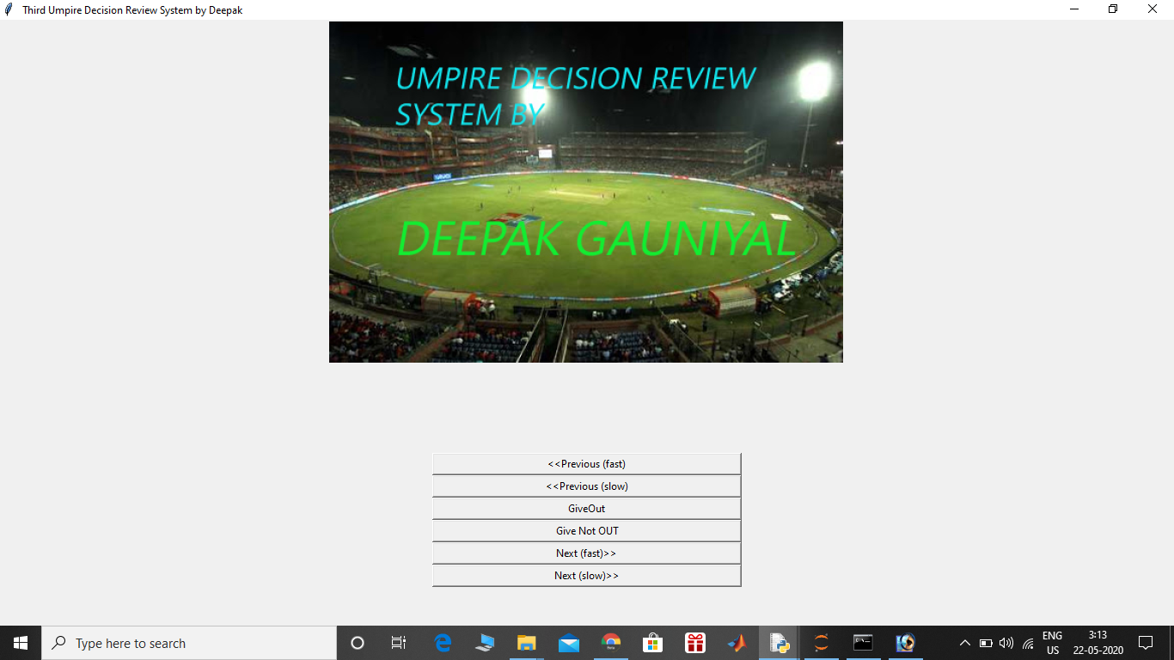
S C R E E N
M
A
I
N

Slide 17
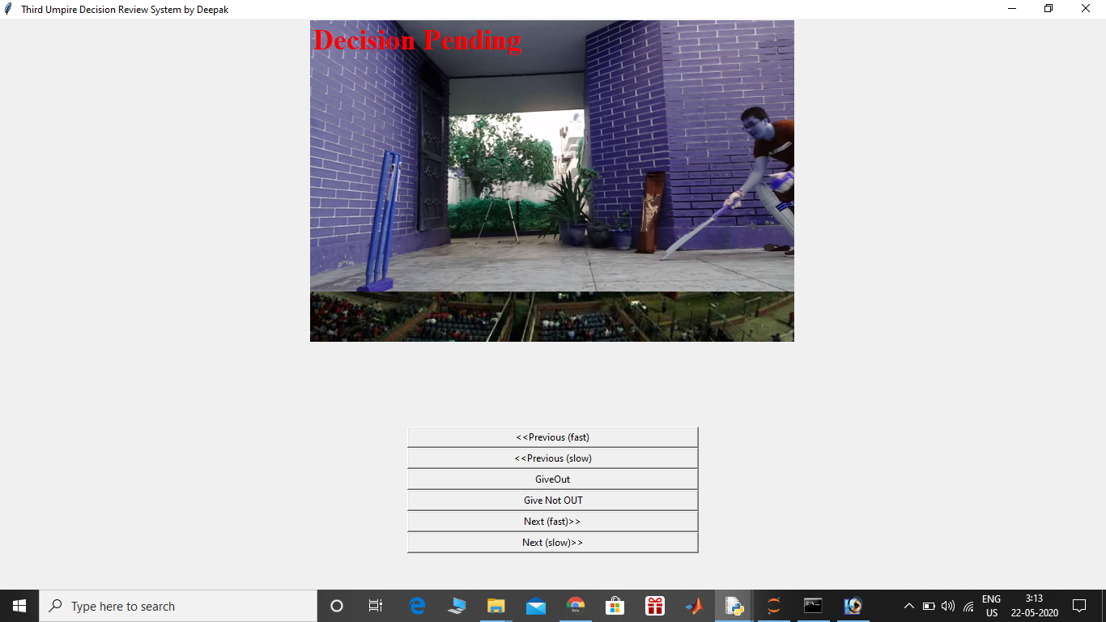
S
T A R T
V I D E O
O F

Slide 18
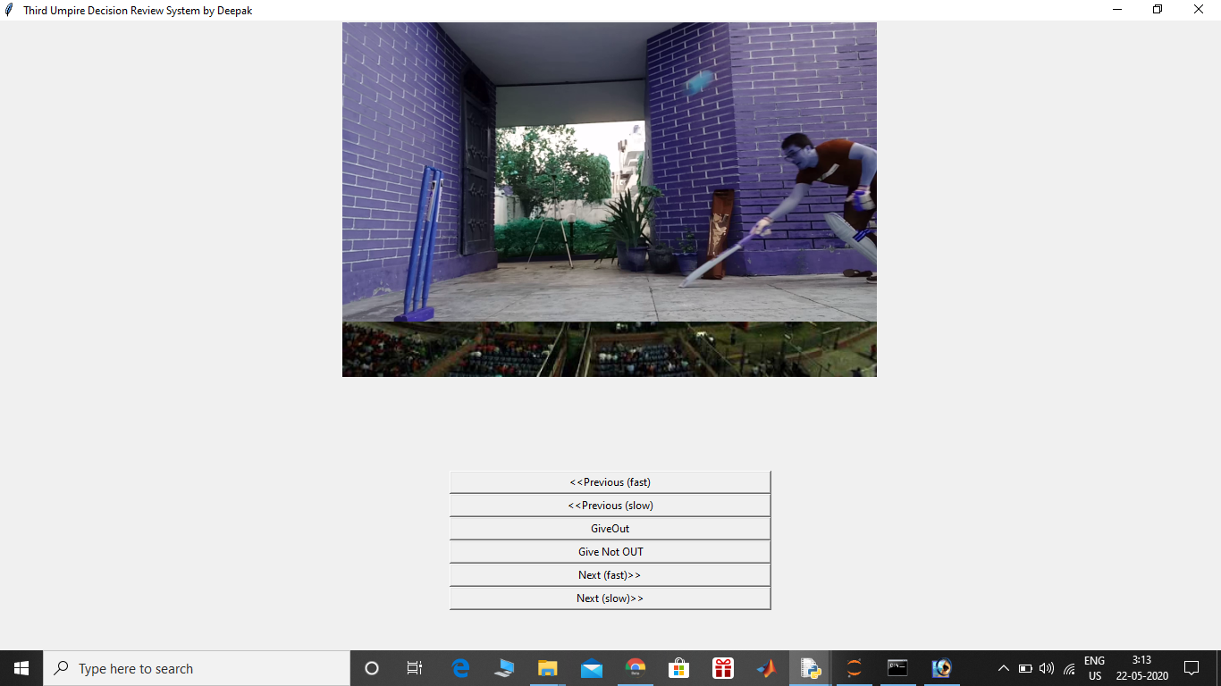
N E X T
S L O W

Slide 19
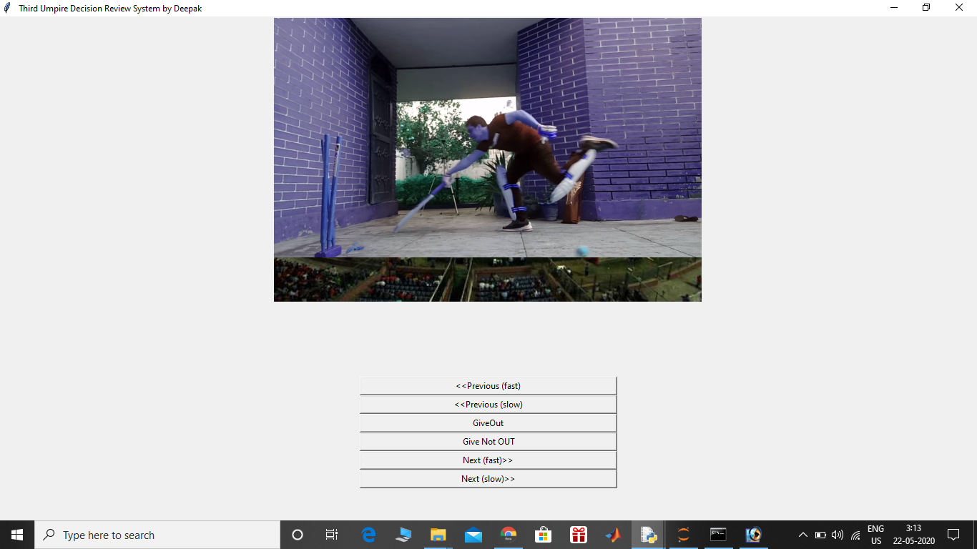
N E X T
F A S T

Slide 20
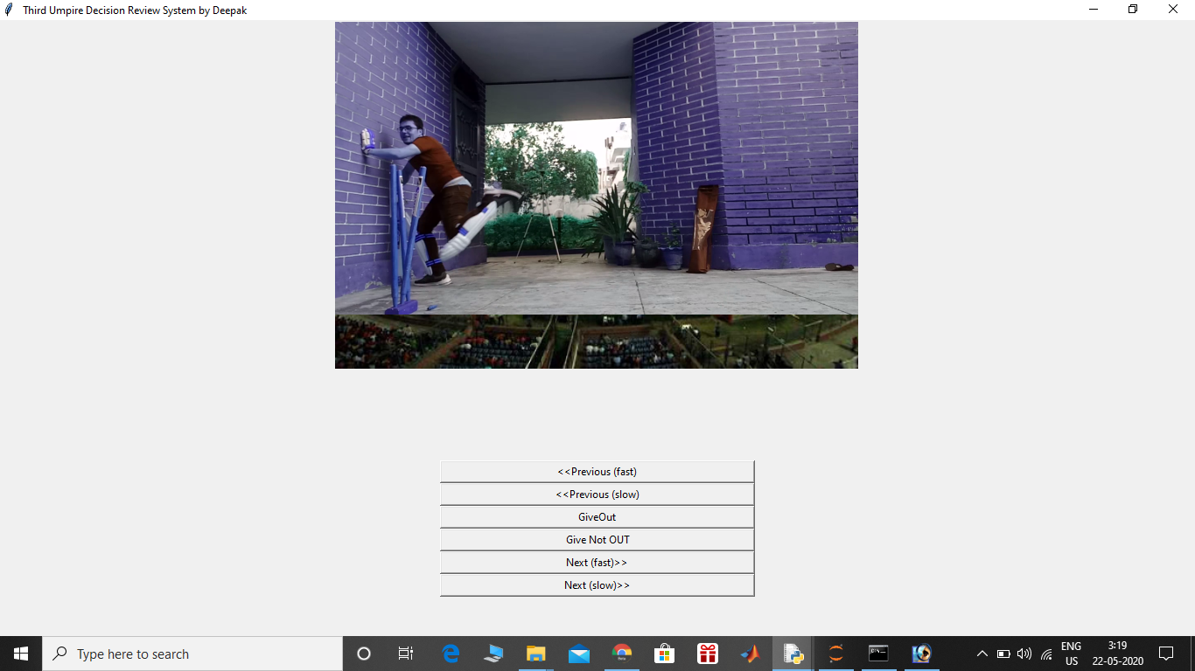
V I D E O
E N D
O F

Slide 21
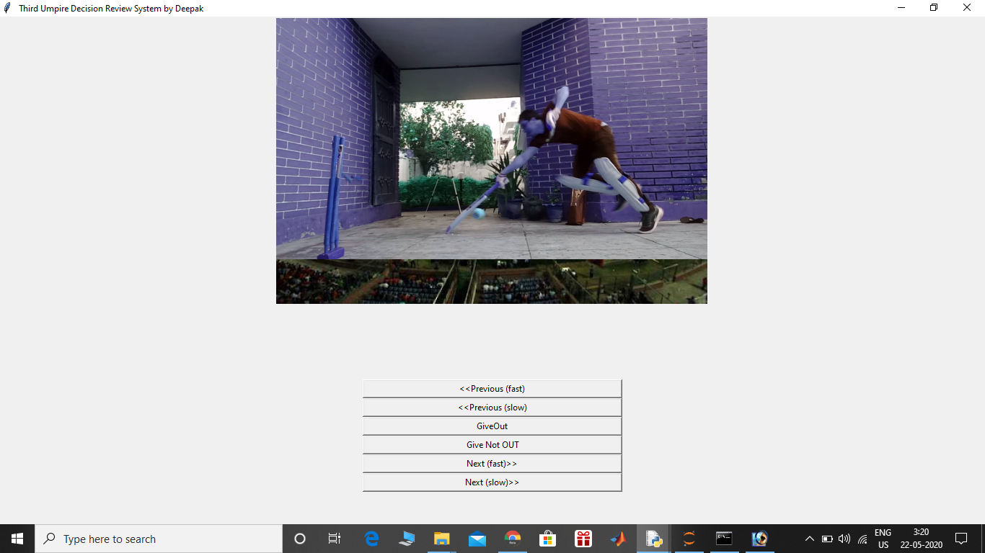
P R E V I O U S
F A S T

Slide 22
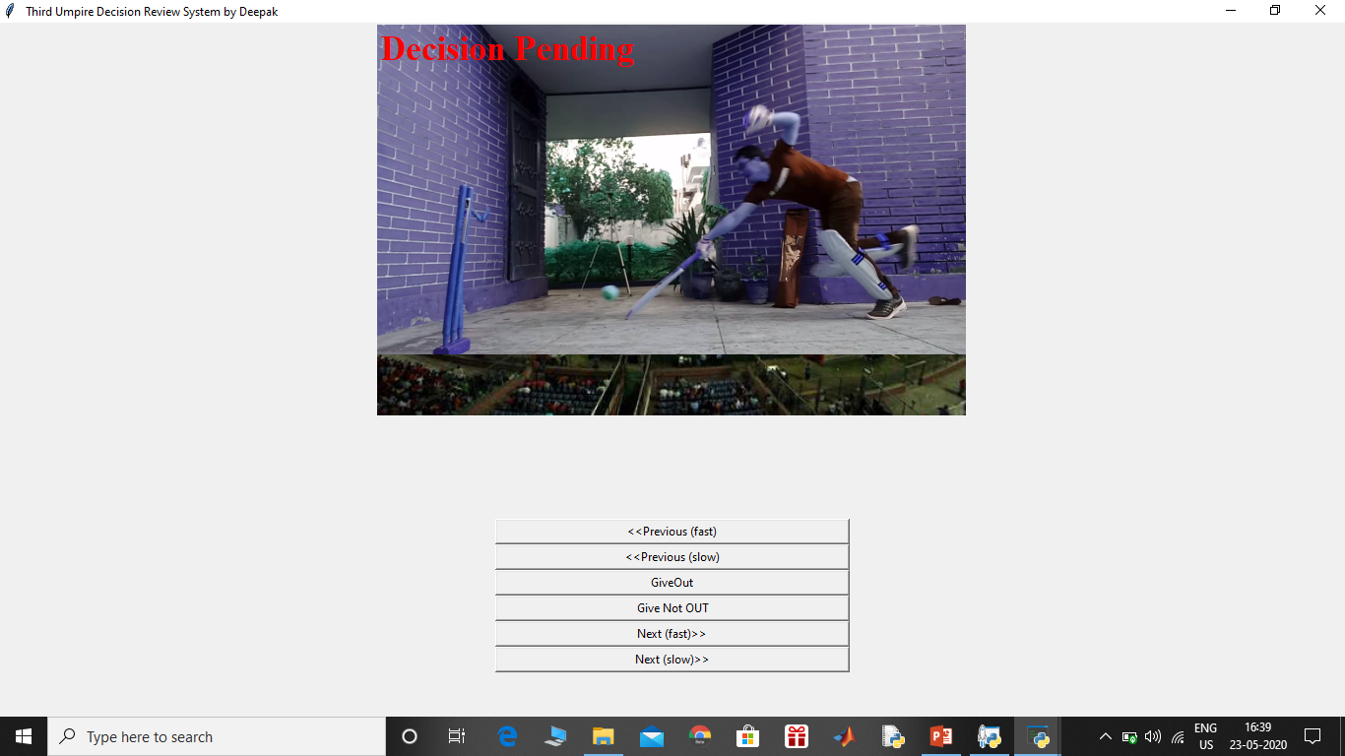
P R E V I O U S
S L O W

Slide 23
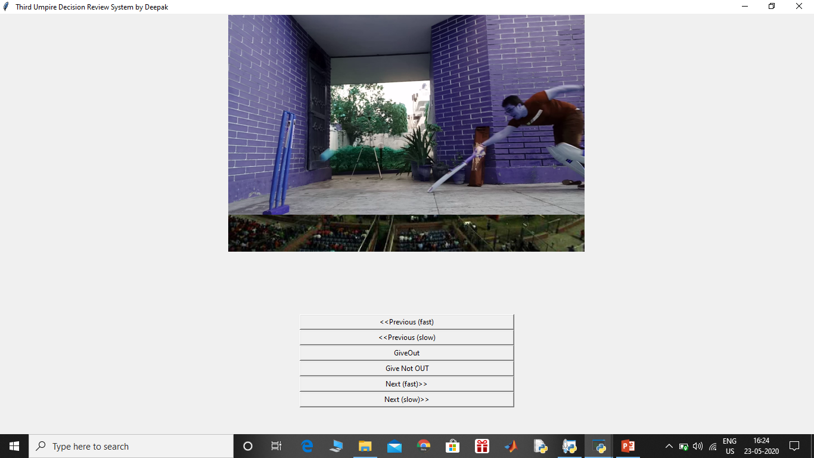
In this batsman is well inside the crease and ball is yet to reach the wicket
So Umpire can now press the “Give Not Out” button

Slide 24
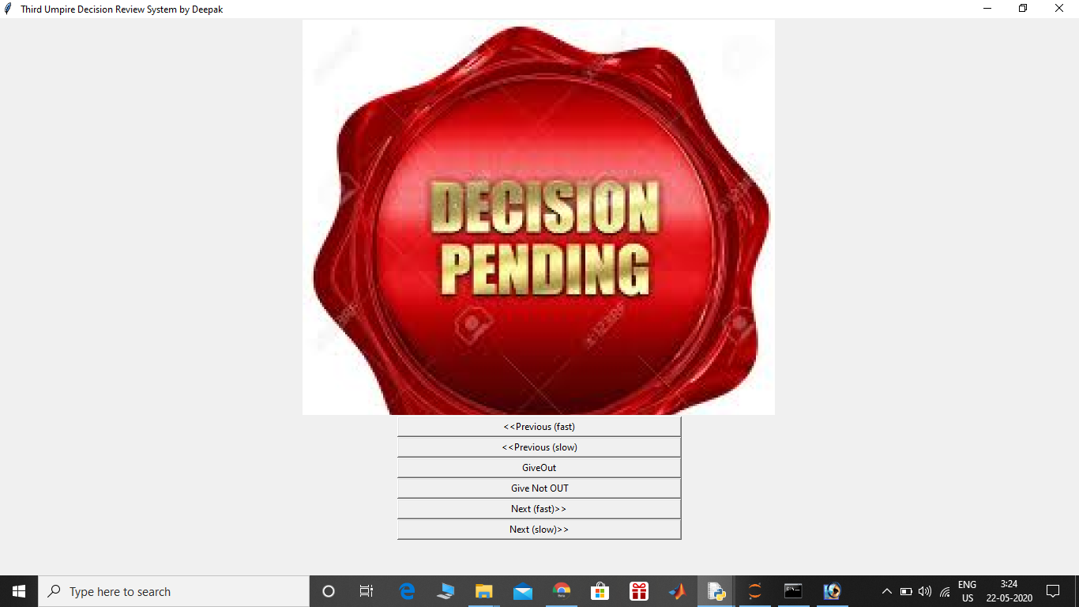
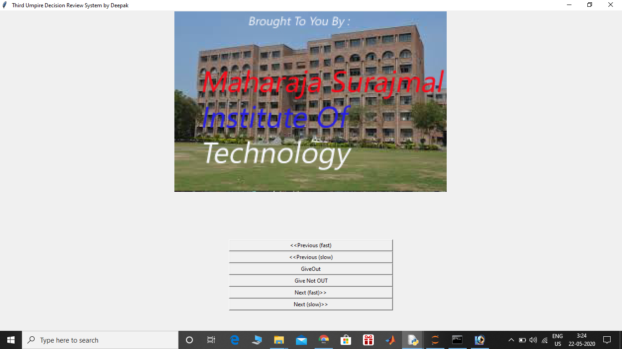
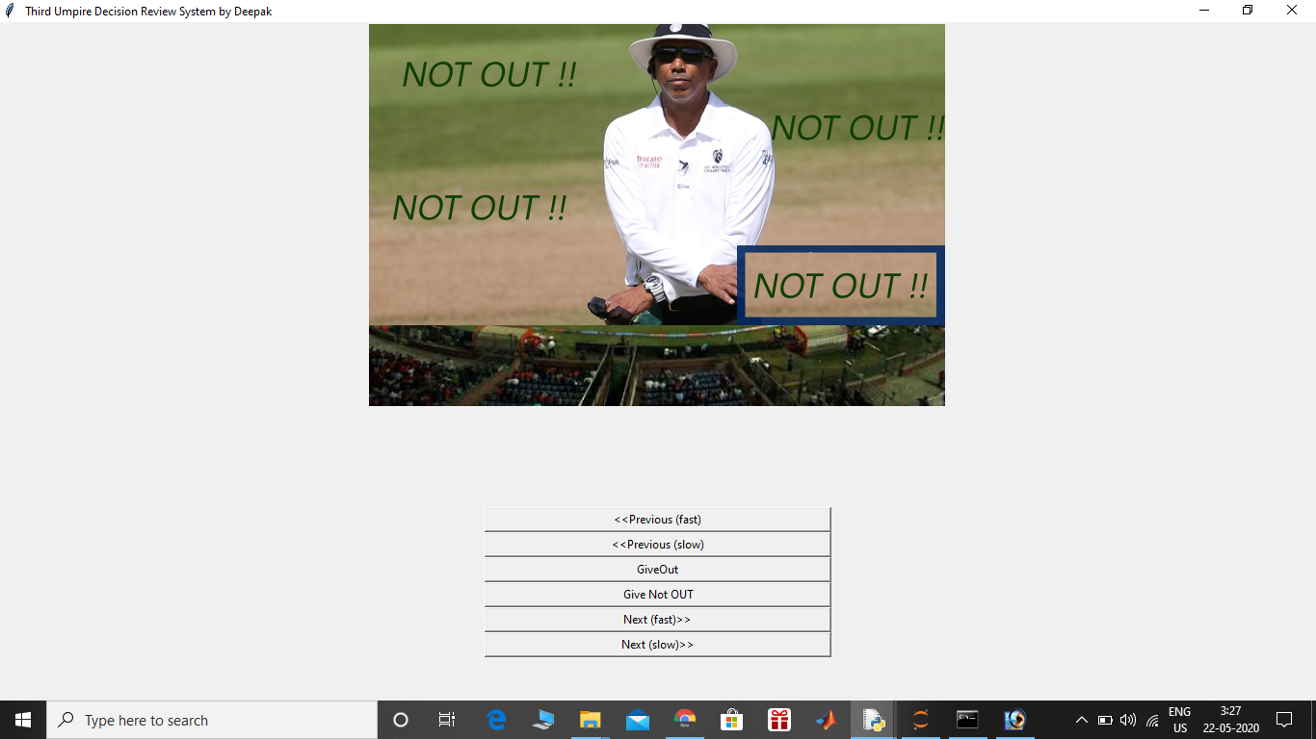
So after pressing “Not out button. We will see 3 windows one after the other
These windows are:
Decision Pending Screen
Our Sponsors
Decision Screen

Slide 25
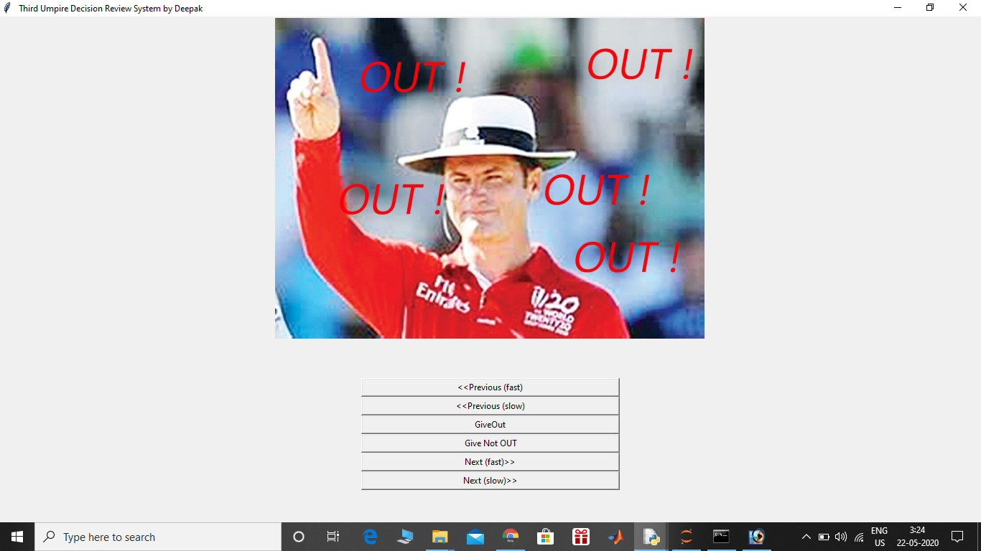
This is the Window after Sponsors one if Umpire’s Decision is OUT

Slide 26
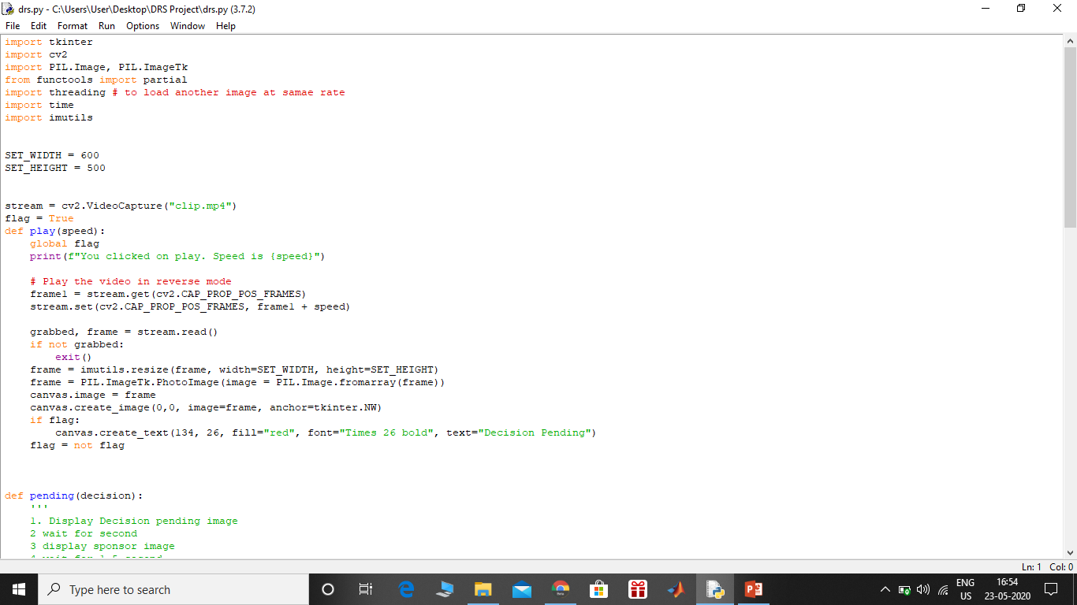
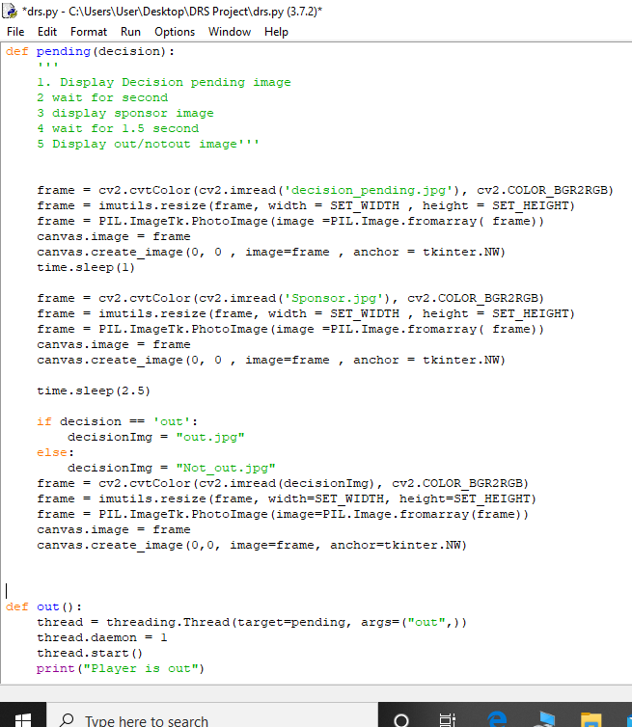
C
O
D
E

Slide 27
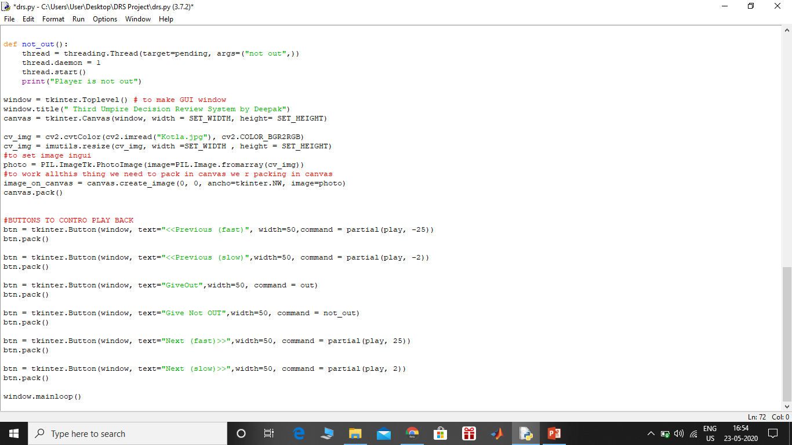

Slide 28
THANK
YOU

